Slide 1







Stack Overflow Developer Survey Analysis
Shriram S
06th Dec 2021

Slide 2



OUTLINE
Executive Summary
Introduction
Methodology
Results
Visualization – Charts
Dashboard
Discussion
Findings & Implications
Conclusion
Appendix

Slide 3

EXECUTIVE SUMMARY
A modified subset of Stack overflow data consisting of two datasets was given. One dataset had the current technology uses and future technology trend data, and the other dataset had demographic details of the surveyors.
Using the given dataset, I created three dashboards.
Future Technology Trend dashboard had top 10 programming languages, database, web framework, and the platforms desired to learn the following year.
Current Technology Usage dashboard had top 10 programming languages, database, web framework, and currently used platforms.
Demographics dashboard had the respondents' age, gender, location, and education level.
From the Current Technology Usage dashboard, it was clear that JavaScript is the most famous language, and MySQL is the most renowned database. Windows was the most famous platform, and jQuery is the most renowned web framework.
From the Future Technology Usage dashboard, it was clear that JavaScript will be the most desired programming language, and PostgreSQL will be the most desired database. Next year, Linux will be the most used platform, and ReactJS will be the most used web framework.
From the Demographics dashboard, it is clear that the majority of the responders were men (93.7%), and most of the respondents were in the age group 24-32. The majority of the respondents had a bachelor’s degree.

Slide 4

INTRODUCTION
Dashboards were created using IBM Cognos Analytics to emphasize the current and future technology trends.
Problem: From such clustered data, we need to analyze the present data technologies and future data trends considering the various demographics of the respondents.
By creating dashboards, we would build visualizations to understand the current and future technology trends based on the respondents’ age, gender, education level, and location.

Slide 5

METHODOLOGY
A modified subset of Stack overflow data consisting of two datasets was given. One dataset had the current technology uses and future technology trend data, and the other dataset had demographic details of the surveyors.
Since the data provided was normalized already, we didn’t have to spend time cleaning the data.
We used IBM Cognos Analytics to build dashboards.

Slide 6
RESULTS
A modified subset of Stack overflow data consisting of two datasets was given. One dataset had the current technology uses and future technology trend data, and the other dataset had demographic details of the surveyors.
In the following few slides, we will be discussing the crucial findings from the dataset.

Slide 7
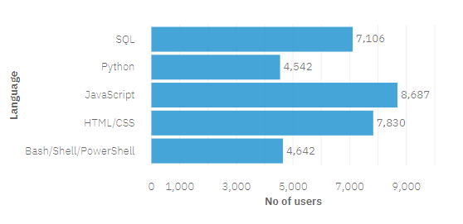
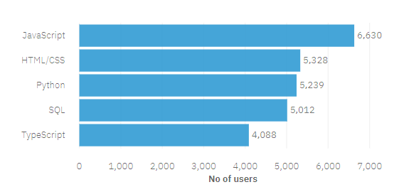
PROGRAMMING LANGUAGE TRENDS
Current Year
Next Year

Slide 8
PROGRAMMING LANGUAGE TRENDS - FINDINGS & IMPLICATIONS
Findings
JavaScript, HTML/CSS were the languages mainly used currently, and from the future technology dashboard, it’s clear that they would continue to be the leading programming languages.
Python will continue to grow in popularity as it’s the most widely used programming language in the Data Science world.
SQL continues to be one of the most used languages.
Implications
From the data, it’s clear that web development will be the most demanded skill.
There is a shift in the platform from Windows to Linux, and Docker and AWS will be more prevalent in the future.
It’s clear that people are learning new skills.

Slide 9
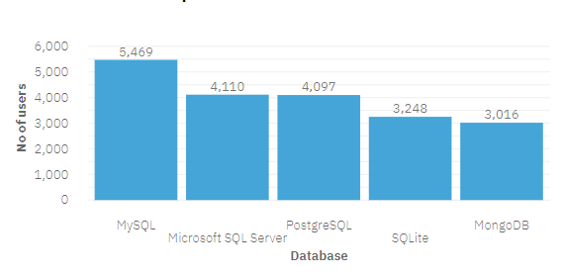
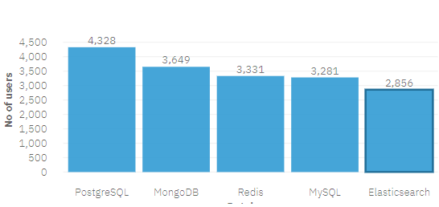
DATABASE TRENDS
Current Year
Next Year

Slide 10
DATABASE TRENDS - FINDINGS & IMPLICATIONS
Findings
MySQL is the leading database, but PostgreSQL and MongoDB will overtake it.
Surprisingly, SQLite will be used by people lesser in the following year.
Redis will have a steady growth.
Implications
With the popularity of NoSQL databases, MongoDB will continue to grow in the future.
Knowing to work on different databases would be crucial as the trend changes every year.
PostgreSQL will grow in popularity further.

Slide 11

DASHBOARD
Stack overflow survey dashboard

Slide 12
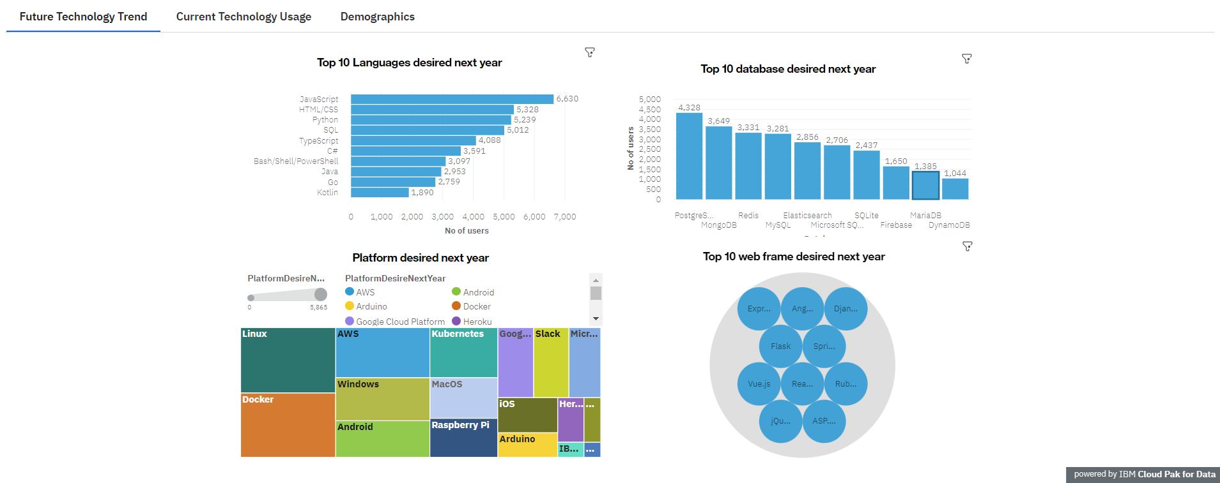
DASHBOARD TAB 1

Slide 13
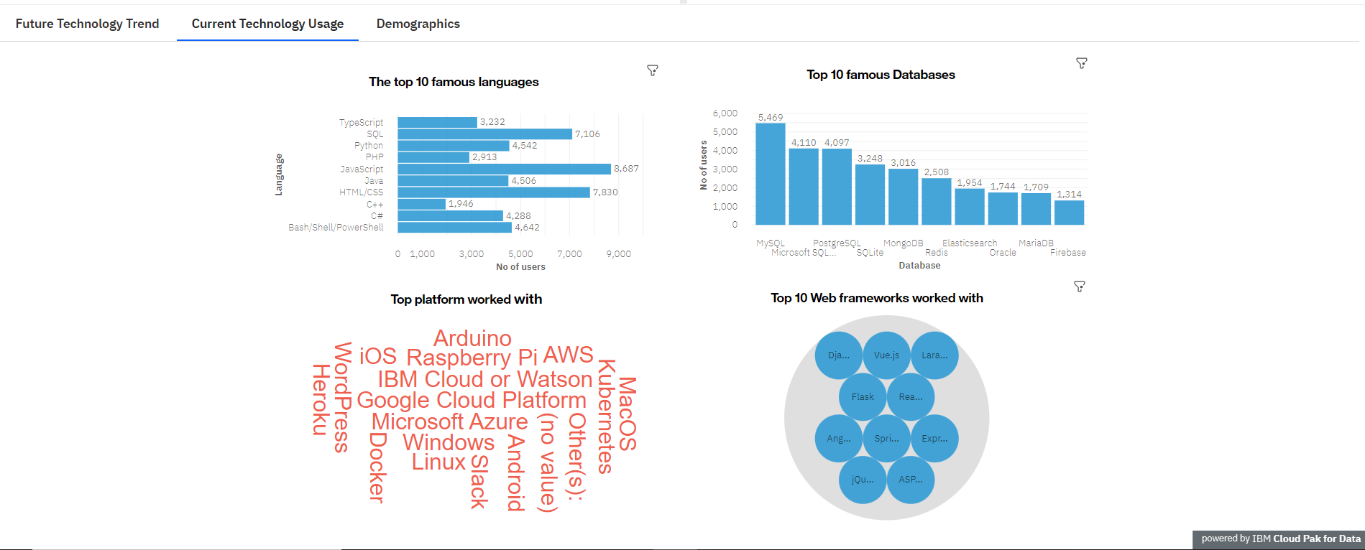
DASHBOARD TAB 2

Slide 14
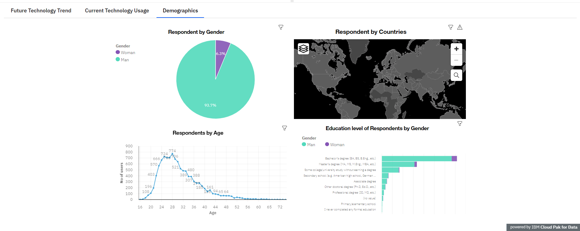
DASHBOARD TAB 3

Slide 15
DISCUSSION
Languages:
Will Go, Rust, and Kotlin continue their rise?
Will Python overtake JavaScript and HTML/CSS?
Databases:
NoSQL is the way forward?
PostgreSQL and MongoDB will continue to lead the pack?

Slide 16
OVERALL FINDINGS & IMPLICATIONS
Findings
The survey was dominated by male respondents. USA and India had the most surveyors.
Majority of the surveyors just had a bachelor’s degree.
Implications
Going by the education level of the respondents, it might look like a bachelor’s degree would be enough if you intend to work in the industry.
Going by the age of the respondents, people are starting to learn from a young age.

Slide 17

CONCLUSION
HTML/CSS and JavaScript will continue to be the most popular languages.
MySQL may be replaced by PostgreSQL and MongoDB as the top database in the future.
It is essential to learn new technologies and keep us updated as per the current market trend.

Slide 18
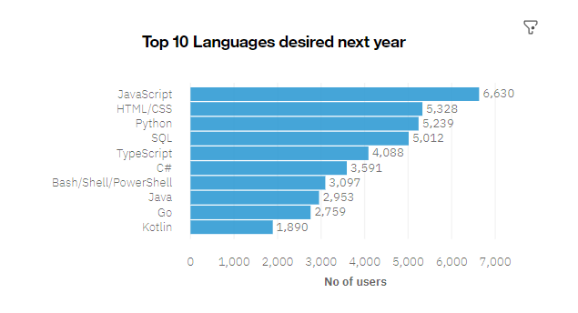

APPENDIX

Slide 19
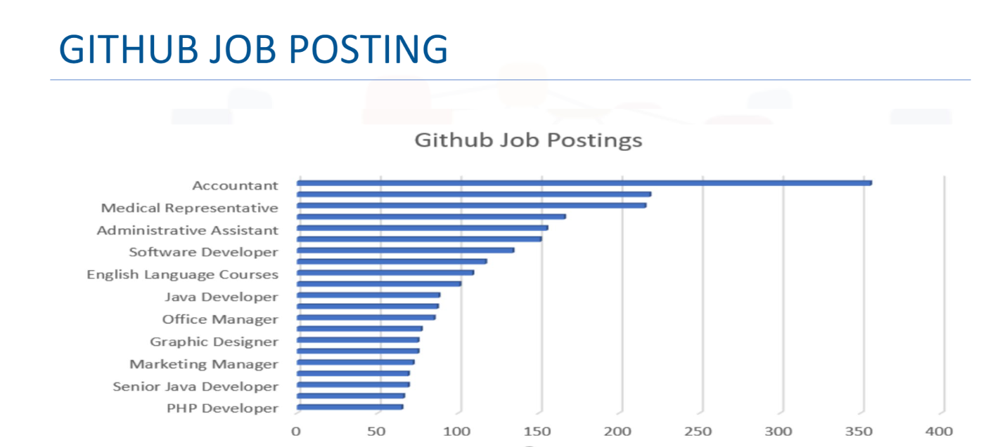
GITHUB JOB POSTINGS

Slide 20
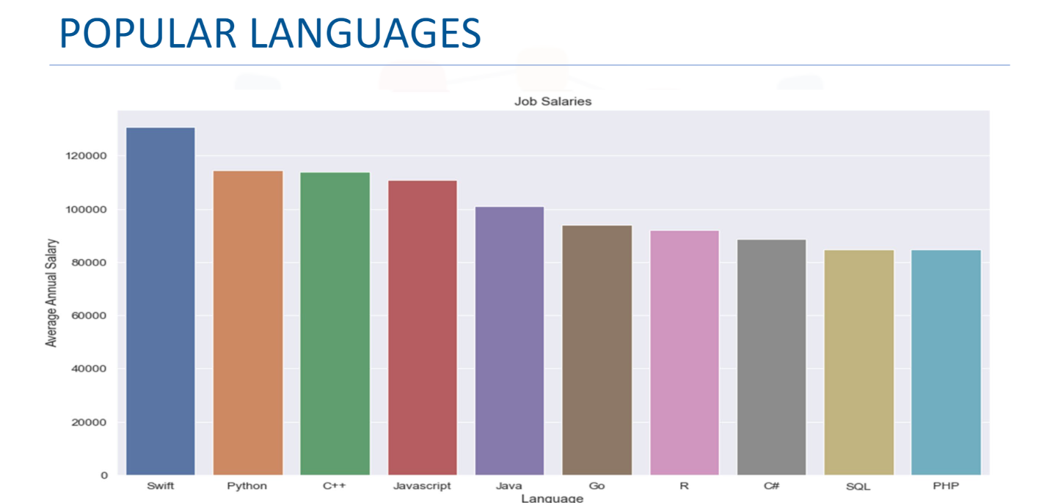
POPULAR LANGUAGES

